Slide 1
HACKATHON BRIEF
#BuildwihAI Global Hack: Natural Language Processing!
Details: Everyday, thousands of messages, conversations and tweets are shaped by worldwide events, interesting trends and other community phenomena. From Presidential tweets affecting stock prices, hashtags affecting social issues, or protests influencing public policies: causes and effects based on the human language are insightful as they are impactful. We want teams to use any social media posts, news feed articles, policy decisions and COVID statistics, to extract interesting insights or correlations.
Requirements: Solutions must have a component using natural language processing techniques. There are no database restrictions.
Judging Criteria: There are three equally weighted judging criteria for this challenge:
1. Innovation and originality of solution 2. Potential economic or social impact of model 3. Technique of solution

Slide 2
THE TEAM
REACH FOR THESTARS

Slide 3

Omar Hamed 5:56 PM Hello, I am Omar from Sweden. I’ve just completed my master’s study in Data Science and currently working on my thesis project. I have good experience working on machine learning, deep learning, NLP and computer vision project. I also have a wide experience working in software project management. I am most interested in NLP challenge.

Slide 4
Rapraka90 6:05 PM Hi , My name is Raj Laxmi Prakash, graduated in Business Analytics and Data Sciences in May 2020. I have 6+ years of technical/data science/analytics experience in diverse field. I have used SQL, Hadoop, Python, Tableau, SAS, Alteryx for customer segmentation/ profiling, descriptive, predictive and time-series forecasting. I have worked on various projects related to NLP. Last I worked with Federal Aviation Administration as Data Science intern related to NLP where I automated the reviews process.

Slide 5
Rishab Panyam

Slide 6
Vkunkerkar 6:12 PM I am Vaibhav. I am doing my Masters in Data Science at Illinois Institute of Technology. I completed my Bachelors degree in Computer Engineering from Mumbai University in 2019. I have also completed 2 semesters at Illinois Institute of Technology attending courses in Data Preparation and Analysis, Big Data, Time Series and Database Organization among others. While attending these courses I have worked in R, Python and SQL. I have completed online courses in Machine

Slide 7

Samantha Wigglesworth 6:12 PM
Hi everyone, my name is Samantha & I am a teacher of languages and economics, I have a background in data analytics/BI, web building and CRM Project implementations in both the public & private sector and have worked for multinationals in medical /manufacturing/finance sector. Recently I started to re-build my skills in SQL and learn more Python and now trying to gain experience in ML and AutoML tools, AI and NLP!

Slide 8
OUR MENTORS
Magno Silva - Expert in XAI, NLP, Time-series data analysis
Susanna Raj - Cognitive Science/HCI Researcher, AI Ethicist, AI Ethics Advisor, Artist and Writer
Johnathan Spitz - Idea generator | Problem solver | Tech+Business

Slide 9
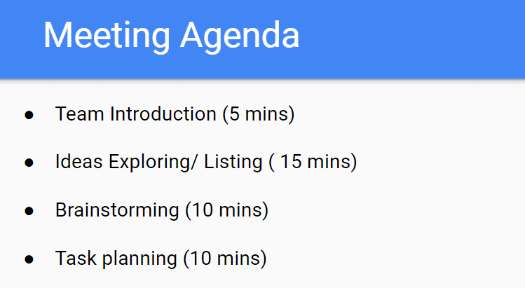
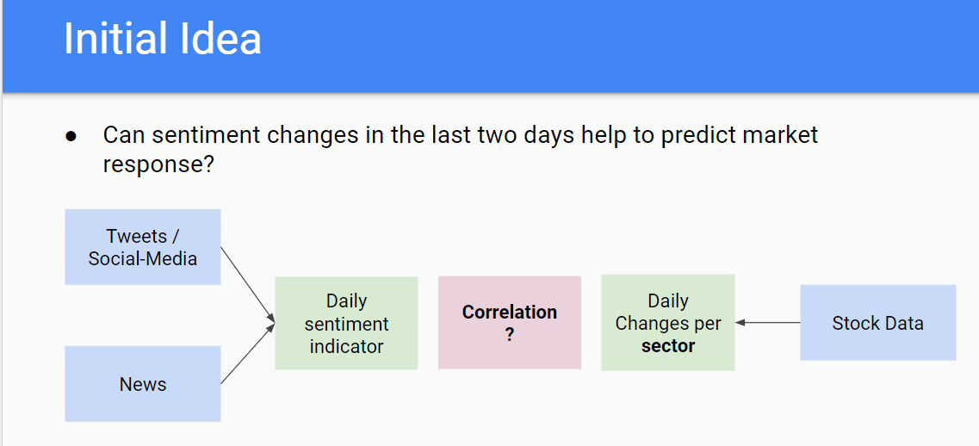
Initial Meeting

Slide 10
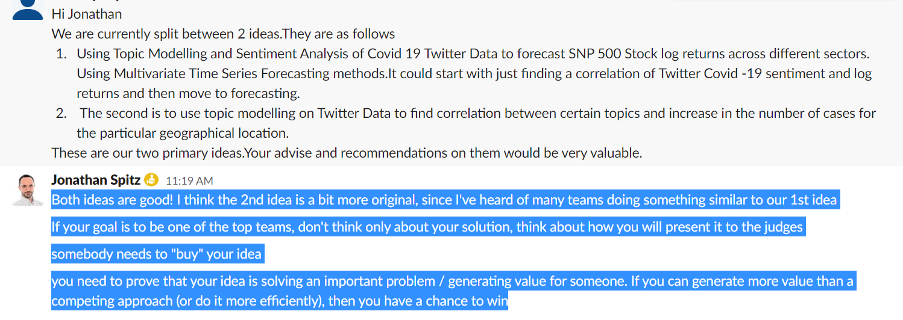
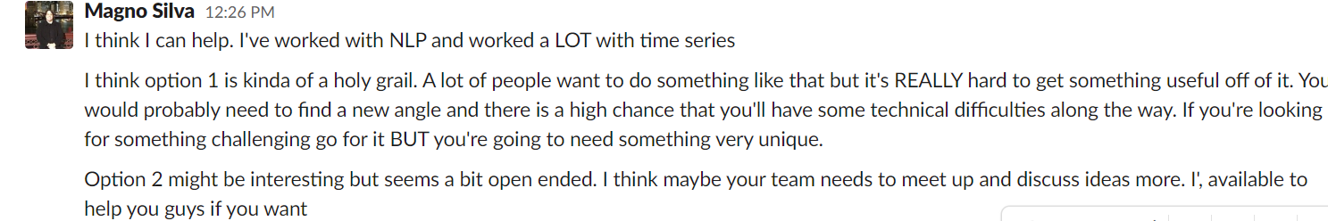
IDEAS STORMING
As an initial idea for the NLP project I think we can find geo-tagged tweets and do sentiment analysis and then find correlation between the sentiment and jobs and wages data in Australia (as this dataset has been shared by Steve Nouri). What do you think? Similarly we can find correlation with stock market in USA if we have the needed data.
I was thinking along the lines to investigate how public perception of covid 19 would affect the no of cases in the country.

Slide 11
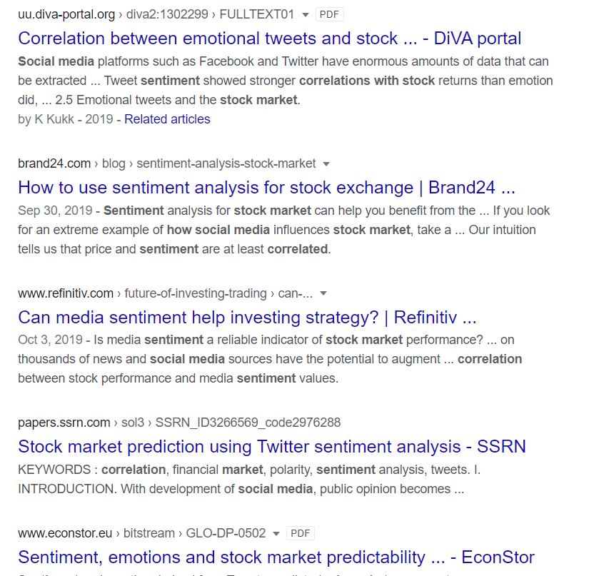
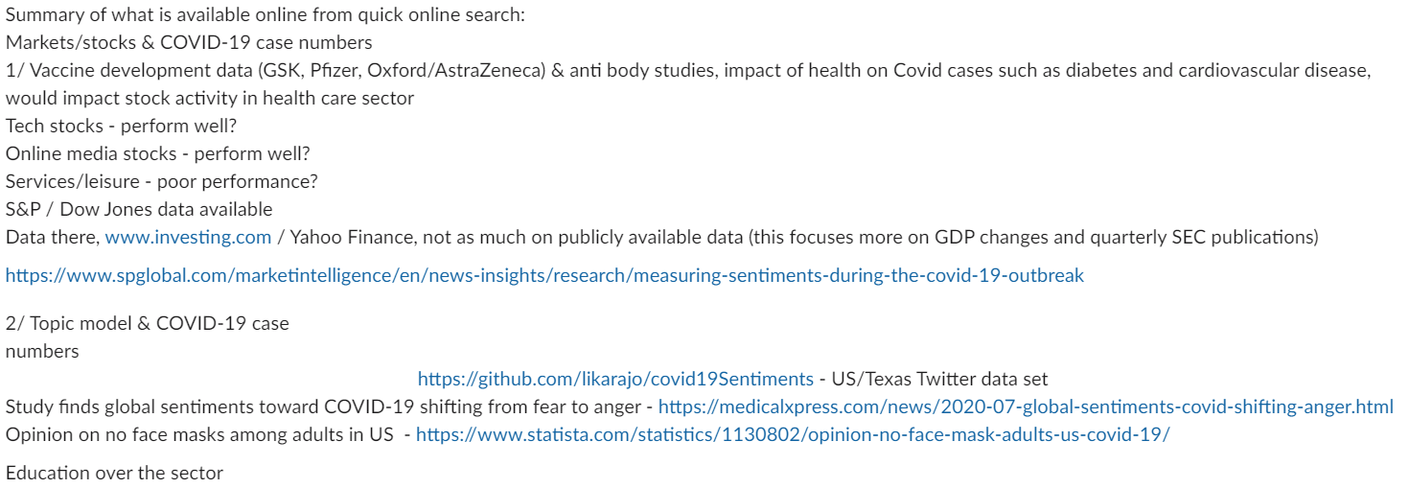
IDEAS STORMING
What data / models already exist on our 2 key project ideas online?
Internet search 25/07/20

Slide 12
PROBLEM WE ARE SOLVING
We believe there is a lack of analysis of responsiveness of daily sentiment changes to the next day stock changes of key industries e.g. Dow Jones U.S. Consumer Goods Index, and more so now during COVID-19.
Using Sentiment Analysis of Covid-19 twitter data we wish to find correlations and relationships with key NASDAQ / S&P 500 Industry stock changes (consumer durables/healthcare/IT services/Internet companies) in addition to predicting patterns and be able to analyse daily changes more closely.

Slide 13
OUR SOLUTION
We have created an NLP model that tracks sentiment changes from Covid-19 twitter data and Industry stock data from the NASDAQ and S&P. By predicting patterns and changes in sentiment on daily / weekly / quarterly stock data across industries and correlation between the sentiment and how it changes could be helpful for analysts and decision makers in business.
It will also have social impact too - users of the NLP model and app will be able to see key correlations across different Topic areas such as Politics, The Economy and COVID-19 and set their desired Industry of interest (Healthcare/Finance/Tech/Internet services).
What techniques or topic areas make your solution impactful and/or effective?
There is evidence that twitter sentiment predicts changes in key industry stocks from the NLP model and visualization tools of COVID-19 twitter sentiment versus key data from the NASDAQ and S&P.

Slide 14
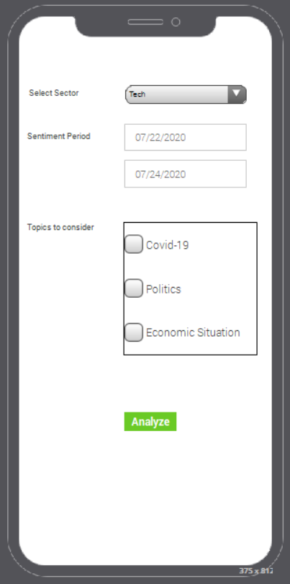
APP UI MODEL

Slide 15
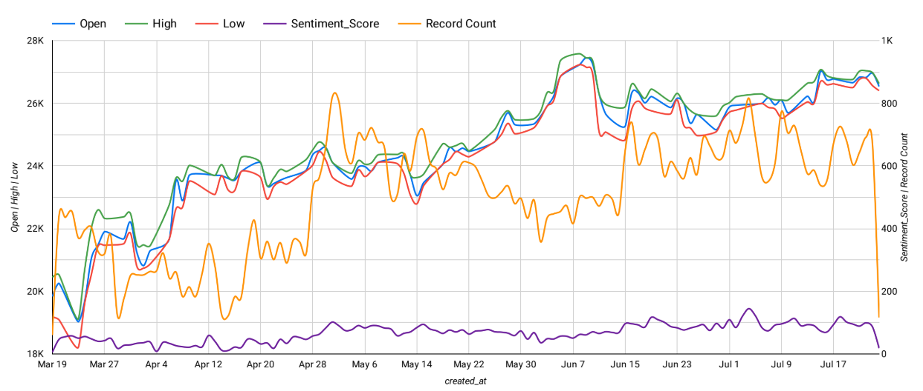
NASDAQ Biotech stocks vs Twitter Sentiment (March-July)

Slide 16
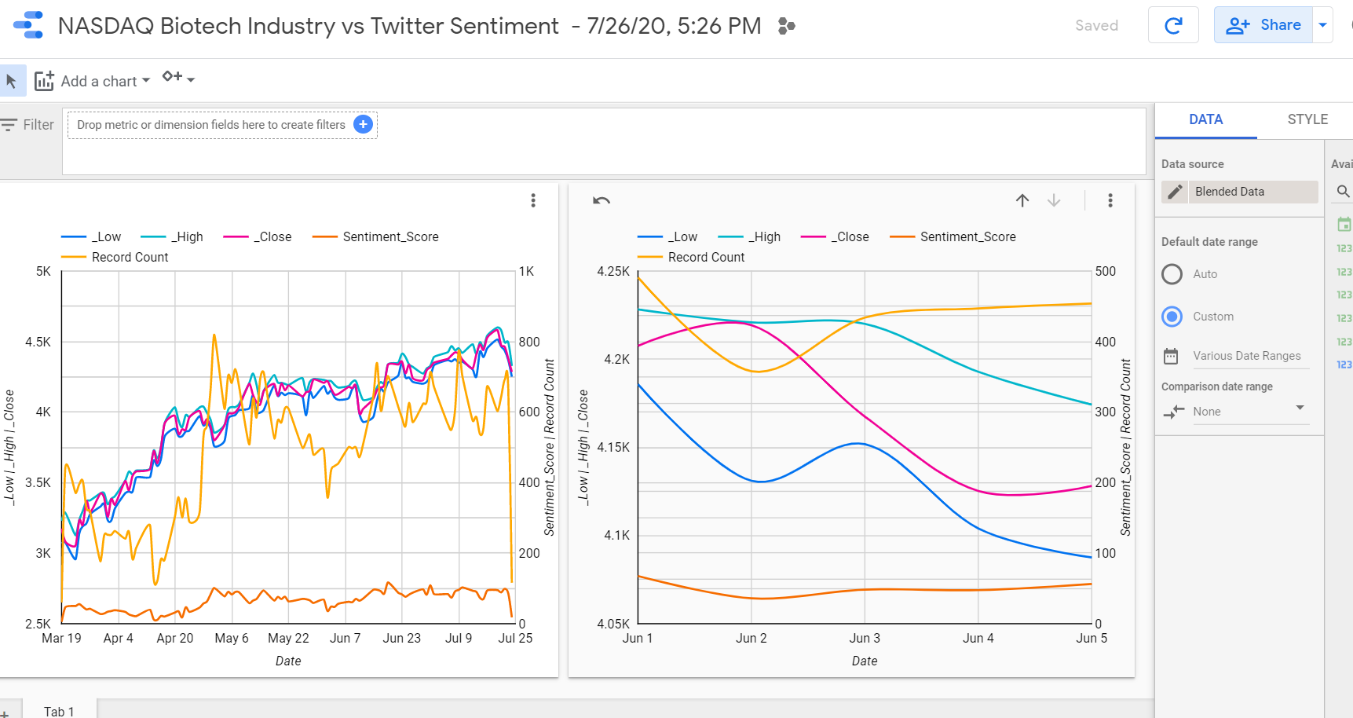
NASDAQ Biotech stocks vs Twitter Sentiment (June 1-5)

Slide 17
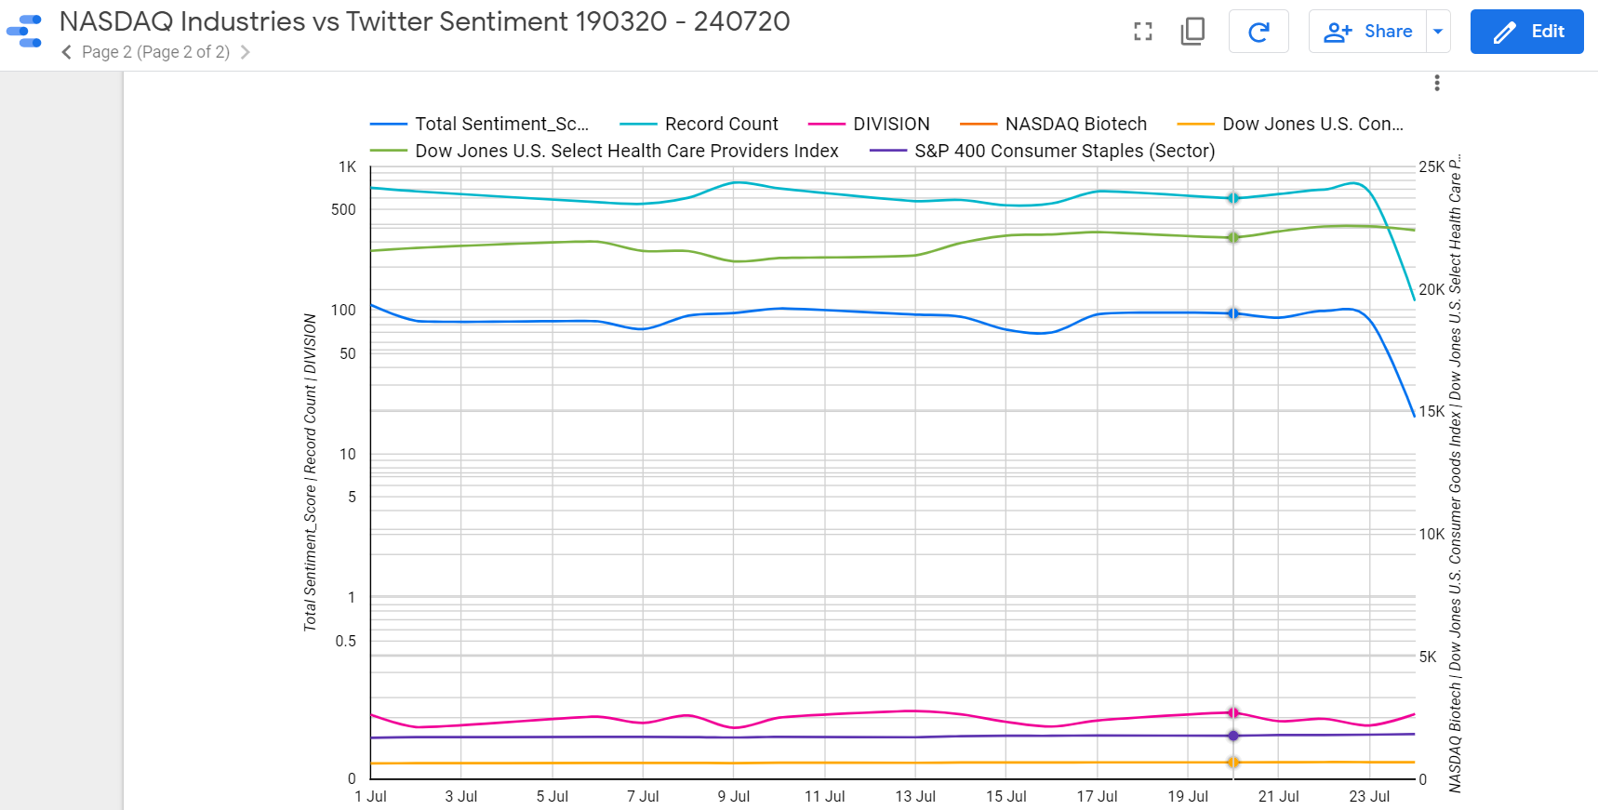
Key Industry Stocks vs Twitter Sentiment (July)

Slide 18
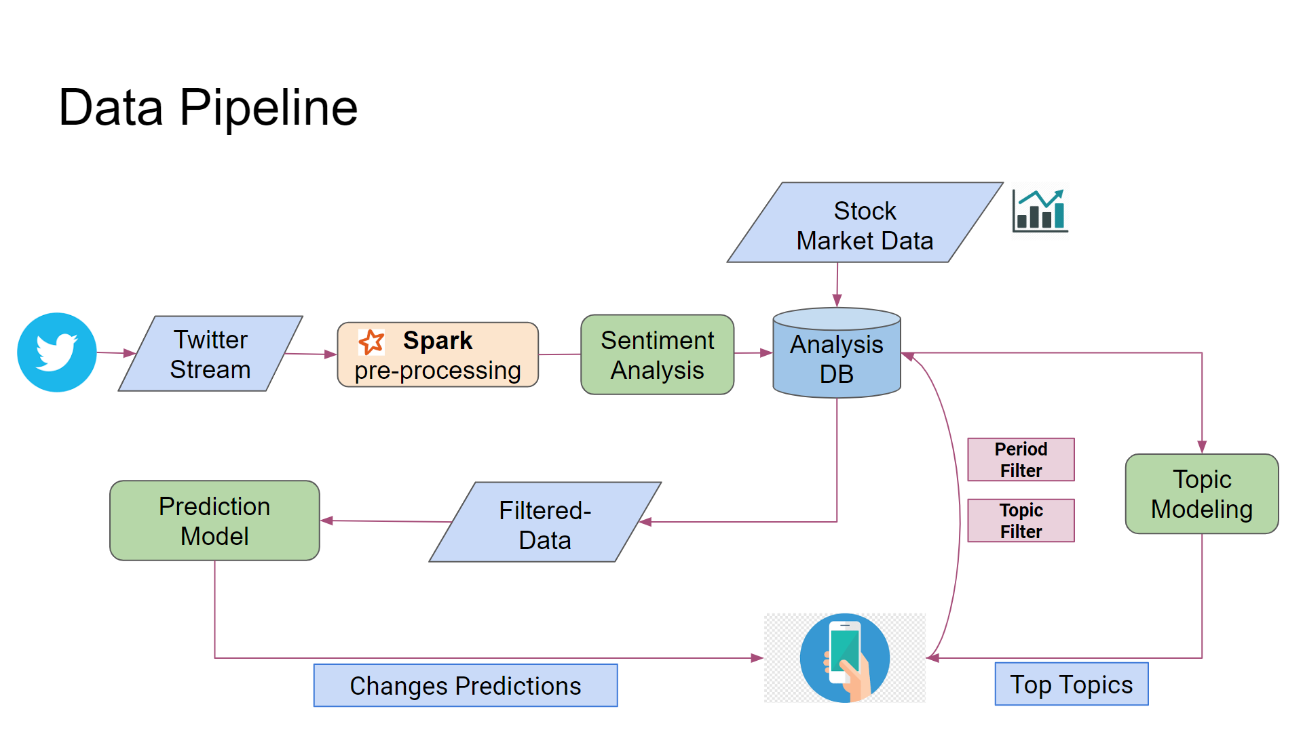
Data Pipeline (NLP Model)

Slide 19
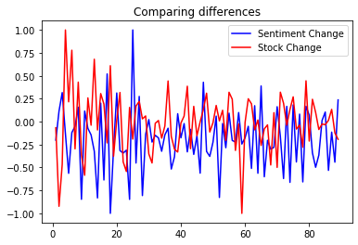

NLP Model
“Looking into one example to see if changes (differences) correlates between sentiment and stock for Dow Jones U.S. Consumer Goods Index.
The second chart when I shift stock change one day backward to compare daily sentiment change with the next day stock change.”
Author O.Hamed

Slide 20
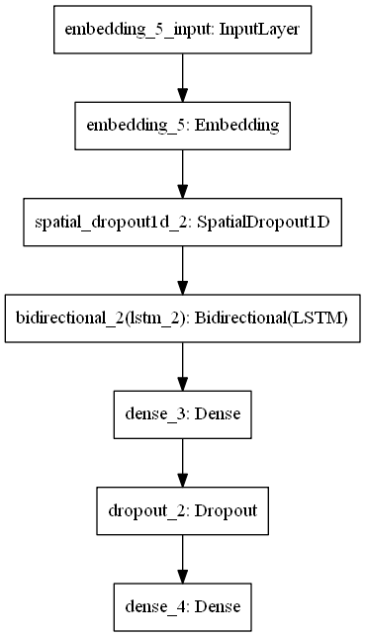
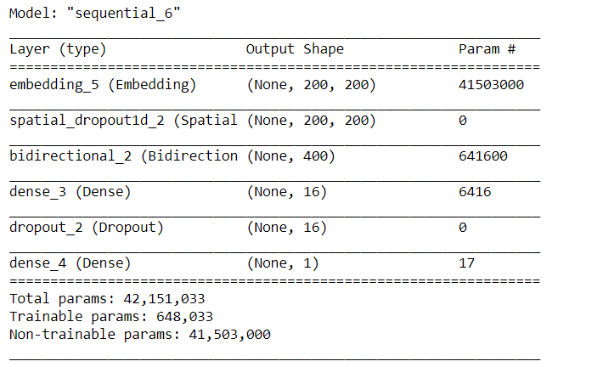
“I believe building and training a LSTM model will require some more time, and hope we can find a ready model to use/test.
Following is the summary of the sentiment analysis model:”
Author O.Hamed

Slide 21
Bibliography
" Predicting the Effects of News Sentiments on the Stock Market" Arxiv.org. 2020. [online] Available at: https://arxiv.org/ftp/arxiv/papers/1812/1812.04199.pdf [Accessed 25 July 2020].
US/Texas Twitter data set, github.com, 2020. [online] Available at Https://github.com/likarajo/covid19Sentiments.
“Study finds global sentiments toward COVID-19 shifting from fear to anger”2020. [online] Available at https://medicalxpress.com/news/2020-07-global-sentiments-covid-shifting-anger.html [Accessed 25 July 2020].
“Opinion on no face masks among adults in US” Statistica.com. 2020. [online] Available at https://www.statista.com/statistics/1130802/opinion-no-face-mask-adults-us-covid-19/.
2020. [online] www.investing.com [Accessed 25 July 2020]
2020. [online] www.yahoofinance.com [Accessed 25 July 2020]
Publicly available data (this focuses more on GDP changes and quarterly SEC publications) www.console.google.com/bigquery, 2020. [online] [Accessed 26 July 2020]
https://www.spglobal.com/marketintelligence/en/news-insights/research/measuring-sentiments-during-the-covid-19-outbreak 2020. [online] [Accessed 26 July 2020].
https://www.mckinsey.com/business-functions/strategy-and-corporate-finance/our-insights/the-coronavirus-effect-on-global-economic-sentiment# 2020. [online] [Accessed 25 July 2020].
https://datasetsearch.research.google.com/ 2020. [online] [Accessed 25 July 2020]
https://www.kaggle.com/sudalairajkumar/covid19-in-usa 2020. [online] [Accessed 25 July 2020]
https://data.humdata.org/dataset/novel-coronavirus-2019-ncov-cases global datasets of COVID 19 2020. [online] [Accessed 25 July 2020].
https://ieee-dataport.org/open-access/coronavirus-covid-19-geo-tagged-tweets-dataset “geo-tagged tweets related to the COVID-19 pandemic.” 2020. [online] [Accessed 25 July 2020]
https://www.investing.com/indices/us-30-historical-data “Historical data for the Dow Jones”, 2020. [online] [Accessed 25-26 July 2020].
,,The Economics of a Pandemic: a case OF COVID-19” Dropbox.com. 2020. [online] Available at: https://www.dropbox.com/s/wm521646rszpl90/slides_Covid19_final.pdf?dl=0 [Accessed 25 July].
“Text pre-processing , Topic Modeling using LDA and NMF Algorithm” - rapraka/NLP https://lnkd.in/eKEGwRg 2020. [online] [Accessed 25 July 2020].
“Covid cases in the US “ tracktherecovery.org. 2020. [online] Available at: https://tracktherecovery.org/

